Slide 2

Railway ticketing system
Group Members:
Yukta Arham Shail
Sonam Keshav Satyakamini
Abhilasha Aditi Sputhnika
Sachin Prasanthi Shweta
Likith Shaleen Nishika
Shree Varsha

Slide 3
Outline
01
Executive Summary
02
Project Context
03
Scope & Limitations
04
Functional Requirements
05
Non-Functional Requirements
06
Methodology
07
Demo

Slide 4
1. Executive Summary
We understand the DMRC's intention to POD-2
CURRENT CHALLENGES
OBJECTIVES OF THE PROJECT
Scalability
Technology Selection
Design and User Experience
Performance optimization
Security
Collaboration and version control
System integration
Cost effectiveness
Simplify Train booking
Enhance user experience
Support multi-passenger booking
Ensure reliability
Admin control
Improve accessibility
HOW WE HELP DMRC TO ACHIEVE ITS OBJECTIVES
Team division : Frontend team and backend team
Independent development with coordination
Integration
Notes:
DMRC(Delhi Metro Rail Corporation) is our client who have assigned us a target to build a website for the online train booking.
Challenges and objectives:
Scalability: High User Volume: The system must handle a large number of concurrent users, especially during peak hours.
Security: Data Protection: Safeguarding sensitive user information such as personal details and payment information.
Reliability: System Uptime: The system must be highly reliable with minimal downtime.
Cost Management: Budget Constraints: Managing costs effectively while ensuring high-quality development and operation.

Slide 5
2. Project Context
Project introduction: The Delhi Metro Rail Corporation (DMRC) has commissioned us to develop an advanced online ticketing system for the Delhi Metro. This system aims to enhance the commuter experience by providing a convenient, efficient, and reliable method to purchase and manage metro tickets online.
Problem and reason for the project:
Booking train tickets was time-consuming and complicated due to the lack of a user-friendly platform.
Searching trains, managing bookings, and payments were not seamless, leading to user frustration.
The project was created to simplify the booking process with an easy-to-use platform.
Features like train search, multiple passenger booking, and secure payments aimed to improve user
experience

Slide 6
3. Scope & Limitation
Scope of the Project
Development of Online Ticketing System
User Management
Ticket Purchase and Management
Real-Time Information
Notifications
Security and Compliance
Customer Support
Reporting and Analytics
Limitations of the Project
Dependency on Internet Connectivity
Technical Challenges
Data Security
Scalability
Regulatory Compliance
Maintenance and Support
Cost Constraints
Notes:
Scope of the Project
1. Development of Online Ticketing System:
Web Application: Creating a responsive web application for purchasing Delhi Metro tickets.
Mobile Application: Developing a mobile application for both Android and iOS platforms to enable ticket purchases on-the-go.
2. User Management:
User Registration and Login: Implementing user registration, login, password management, and profile management features.
User Dashboard: Providing a dashboard for users to view ticket history, upcoming journeys, and account settings.
3. Ticket Purchase and Management:
Ticket Booking: Enabling users to search for routes, select travel times, and purchase tickets online.
Payment Integration: Integrating multiple payment gateways (credit/debit cards, mobile wallets, UPI) for secure transactions.
Ticket Storage: Allowing users to store and manage their tickets digitally within the app.
4. Real-Time Information:
Train Schedules: Providing real-time updates on train schedules, delays, and cancellations.
Station Information: Offering information about stations, including facilities and services available.
5. Notifications:
Alerts and Updates: Sending notifications to users about their journeys, including reminders, delays, and other important updates.
6. Security and Compliance:
Data Encryption: Ensuring all user data and transactions are securely encrypted.
Compliance: Adhering to legal and regulatory requirements for data protection and privacy (e.g., GDPR).
7. Customer Support:
Helpdesk Integration: Providing a helpdesk feature for users to get support and resolve issues.
FAQs and Guides: Offering a comprehensive FAQ section and user guides to assist users.
8. Reporting and Analytics:
Usage Analytics: Tracking and analyzing user behavior and system usage to improve the service.
Operational Reports: Generating reports for DMRC to monitor system performance and user satisfaction.
Limitations of the Project
1. Dependency on Internet Connectivity:
Online Access: Users need a stable internet connection to access the online ticketing system, which might be a limitation in areas with poor connectivity.
Offline Functionality: Limited offline functionality may affect users who cannot access the internet during their journey.
2. User Adoption:
Learning Curve: Some users, especially those not familiar with digital platforms, might face a learning curve in using the online ticketing system.
Resistance to Change: There may be resistance from users who prefer traditional methods of purchasing tickets.
3. Technical Challenges:
System Downtime: Unexpected downtimes or technical issues could disrupt the service and inconvenience users.
Integration with Existing Systems: Integrating the new system with DMRC’s existing infrastructure might present technical challenges.
4. Data Security:
Cybersecurity Threats: Despite best efforts, the system may still be vulnerable to cyber-attacks, data breaches, or fraud.
User Privacy: Ensuring the privacy of user data is maintained at all times can be challenging.
5. Scalability:
Handling High Traffic: The system must be capable of handling high volumes of traffic, especially during peak hours, which may require significant resources.
Expansion: Future expansion and addition of new features might be challenging and require additional development.
6. Regulatory Compliance:
Changing Regulations: Keeping up with and adapting to changing legal and regulatory requirements can be difficult and resource-intensive.
7. Maintenance and Support:
Ongoing Maintenance: Regular maintenance and updates are required to ensure the system remains functional and secure.
Customer Support: Providing timely and effective customer support is essential but can be resource-intensive.
8. Cost Constraints:
Budget Limitations: Developing and maintaining a robust online ticketing system requires substantial financial investment, which might be a constraint.
By clearly defining the scope and understanding the limitations, you can better plan and execute the project, ensuring that it meets the needs of DMRC and its users while being prepared for potential challenges.

Slide 7
4. Technical Overview (1/2)
Functional requirements : "Overview of key functionalities for users and admins, including train search, ticket booking, payment options, and admin control features like report and train management."
Login
User
Search Trains
Booking history
Admin
Book Trains
Payment Options
By station
Financial Report
By train
Train manage
Passenger search

Slide 8
5. Technical Overview (2/2)
The project uses Spring Boot for high performance, scalability and rapid development process. MySQL is optimized with indexing and replication for efficient read scalability and seemless integration with SpringBoot. Next.js ensures a user-friendly interface which is scalable and modern architecture having built in API-integration support, hot reloading and typescript support.
Backend: SpringBoot
Front-end: Next.js
Database: MySQL

Slide 9
5. Technical Overview (2/2)
Estimated monthly costs: Assuming a traffic of 5000 concurrent request on the website.
Runtime Server Cost: $2000- $2500
Estimated establishment cost:
Development (one-time): $5,000 - $25,000
Licensing and Third-Party Services: $200 - $1,000
Maintenance and Support: $5,000 - $15,000
Security and Compliance: $500 - $2,000
Notes:
Website Development Costs in 2025: Complete Pricing Guide

Slide 10

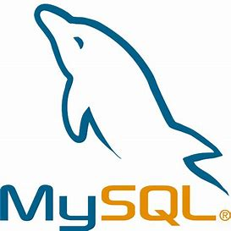

6. Methodology (1/2)
Frontend
Next.Js
Backend
Spring Boot
Database
MySQL
Tech Stack

Slide 11
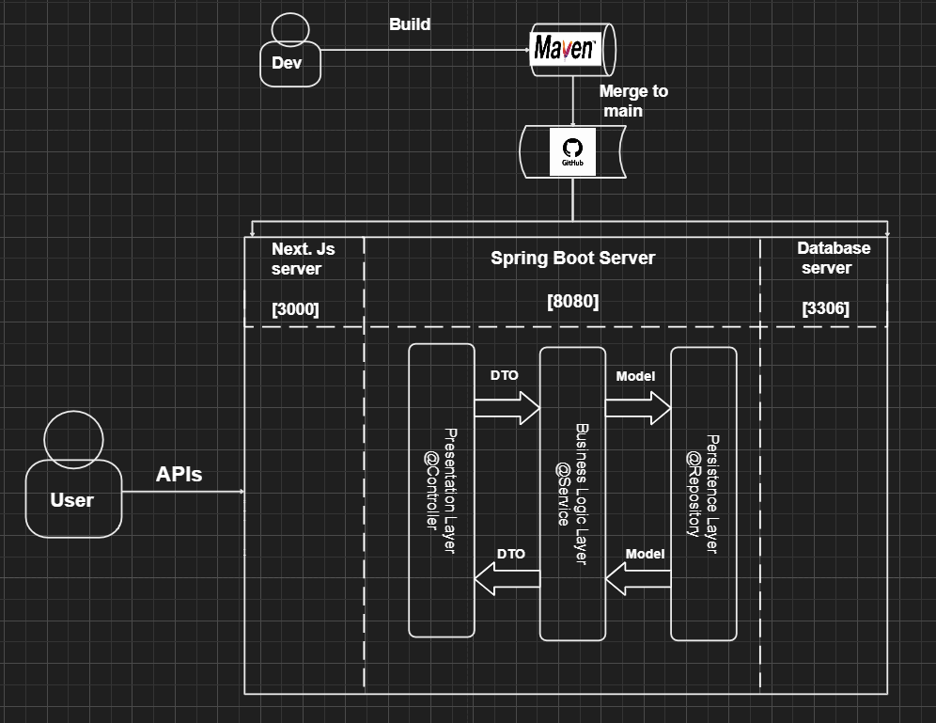
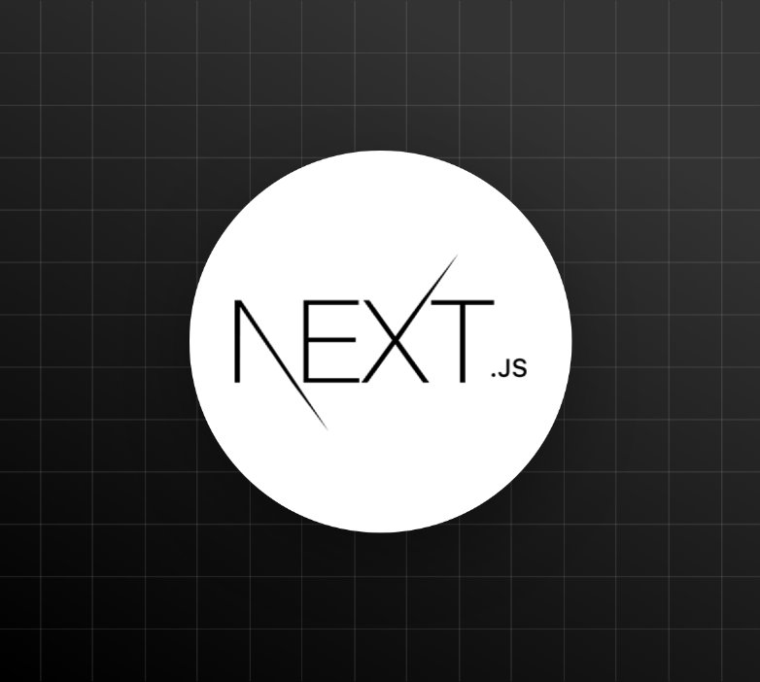

6. Methodology (2/2)

Slide 12
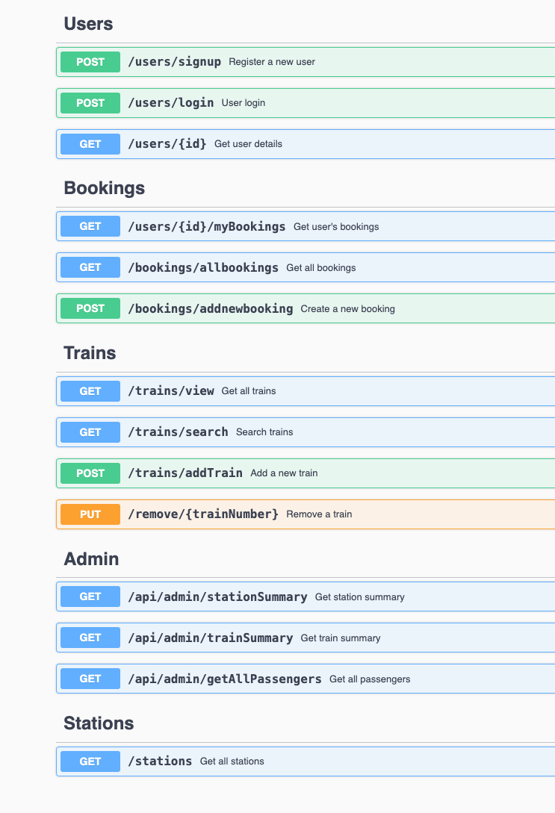
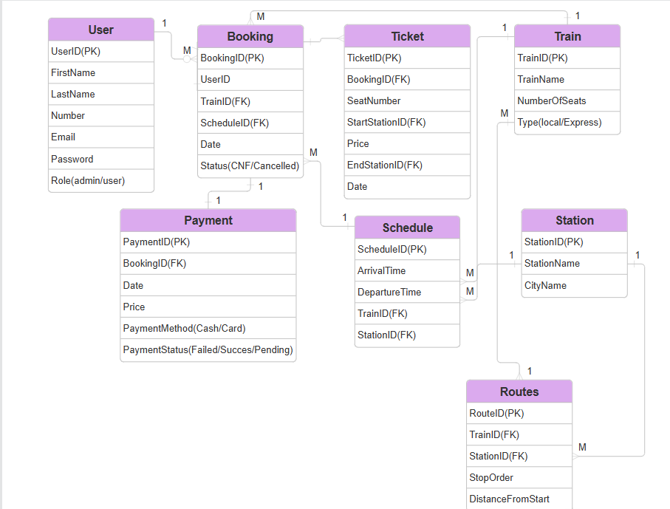
7. Design Overview
API Design
ERD Diagram

Slide 13
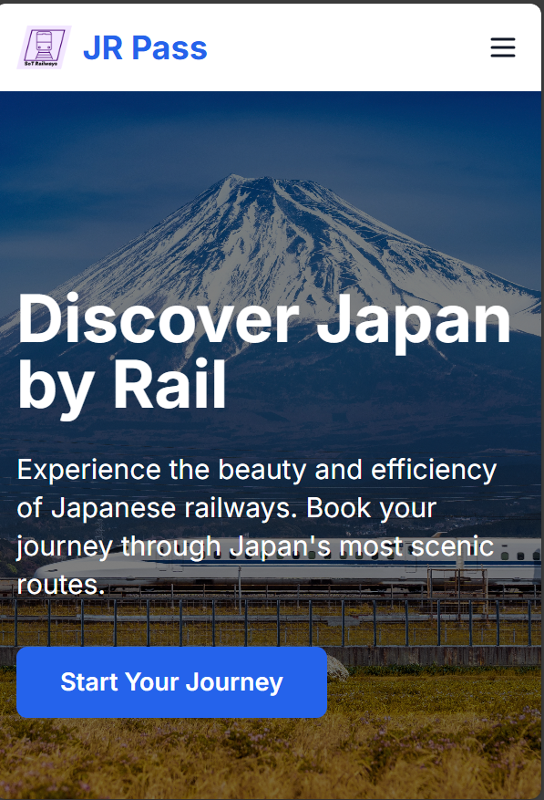
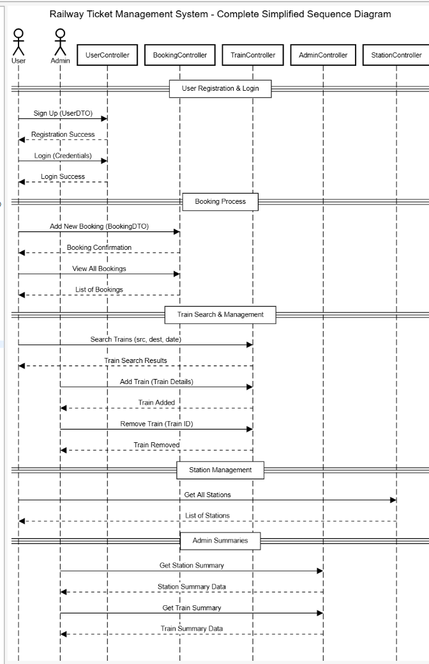
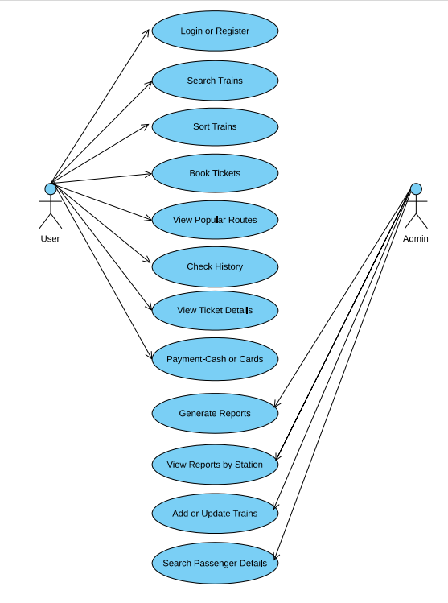
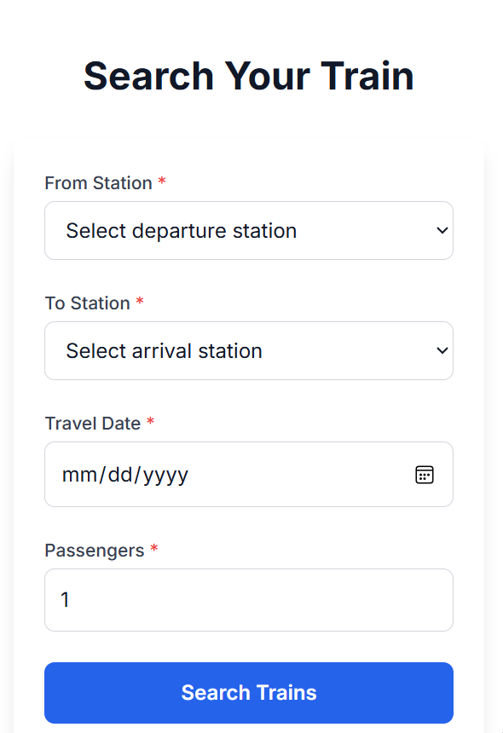
7. Design Overview
UI Design
Sequence Diagram
Use Case Diagram

Slide 14
8. Demo
TBU

Slide 15
Reminders
Limit content per content per slide to 6-8 lines
If figures are placed on the slide, include which page number in the document it can be found for easier access of panel members
Do not memorize your report. You are allowed to use index cards, however, do not just READ your report. Make sure you understand your project and be able to explain it, even without a script
Good Luck!

Slide 16
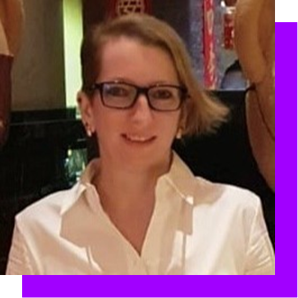
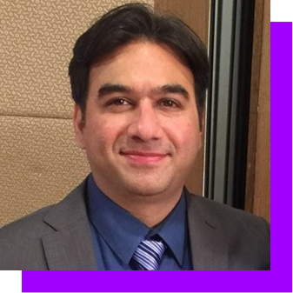


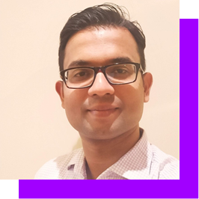
How to Get Help
School of Tech SharePoint
School of Tech - Yammer Community
LinkedIn - #SchoolOfTech
Key Contacts
Katherine Djabri
Saurabh Kataria
Steve Siromani
SoT E-mail
katherine.djabri@accenture.com
saurabh.a.kataria@accenture.com
steve.siromani@accenture.com
SchoolOfTech_AAPAC@accenture.com

Slide 17
Technical Overview – Annexure
Estimated Costs
The cost will depend on the instance types, storage, and data transfer. Here’s a rough estimate:
EC2 Instances:
6 x m5.xlarge (on-demand): ~$1,200/month.
Auto Scaling may increase costs during peak traffic.
RDS Database:
1 x db.m5.xlarge (Multi-AZ): ~$600/month.
Read Replicas: ~$300/month each.
ElastiCache:
1 x cache.r5.large: ~$200/month.
ALB:
~20/month+20/month+0.008 per LCU-hour.
S3:
~300-400/month (depending on data transfer and storage).
Notes:
Website Development Costs in 2025: Complete Pricing Guide

